Slide 1

CareerCompass.ai
AI-powered personalized career & skills advisor
Google GenAI Hackathon 2025 | Samiksha Mundada

Slide 2


Problem Statement
Generic Career Advice
Market Mismatch
Students in India often receive one-size-fits-all career guidance that doesn't consider their unique strengths and interests.
Career guidance fails to adapt to rapidly changing job market demands and emerging technology roles.
Limited AI Solutions
Lack of intelligent, AI-driven personalized career advisory solutions for students seeking tailored guidance.

Slide 3
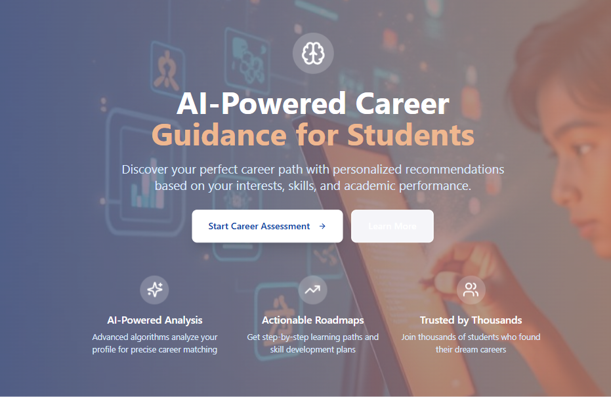
Solution Overview
Personalized Career Roadmaps
CareerCompass.ai generates tailored career pathways by analyzing student inputs including current skills, interests, and educational goals.
Powered by Google's Gemini AI, the platform suggests relevant career paths, identifies skill gaps, and recommends free learning resources for continuous growth.

Slide 4
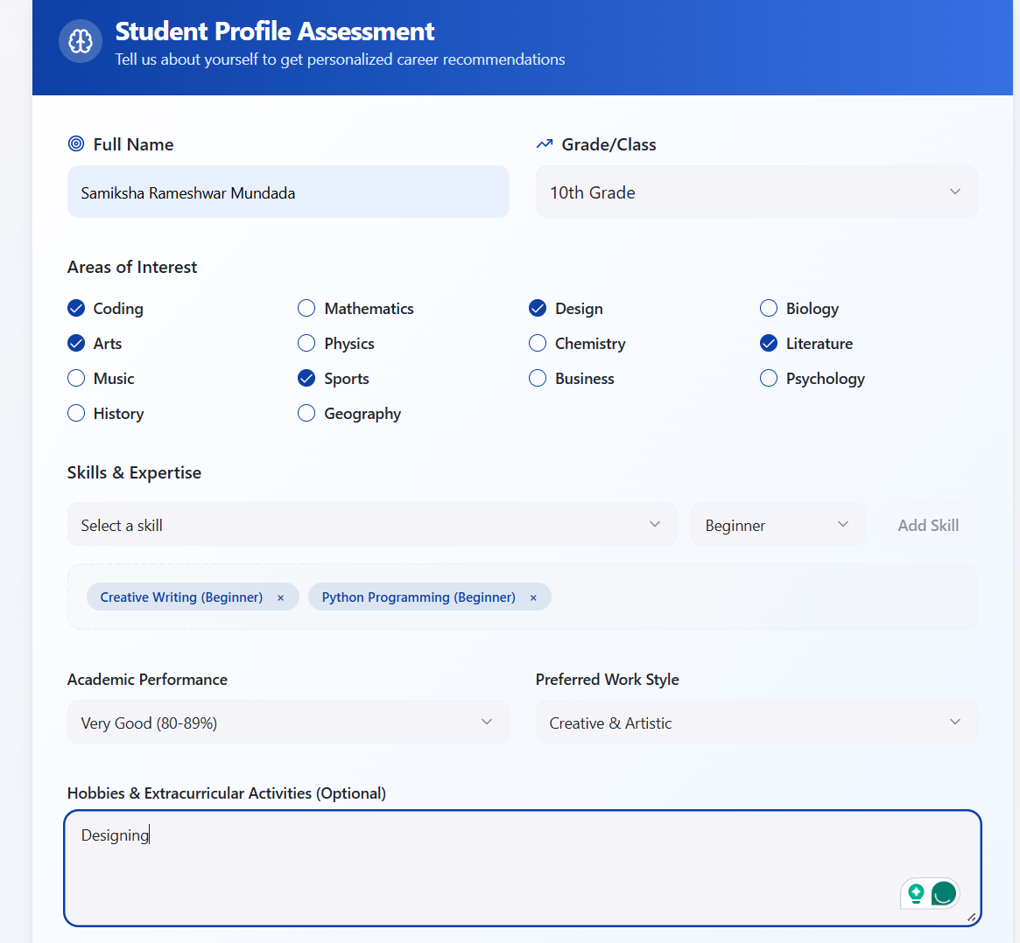



Key Features
Smart Skills Assessment
Interactive forms capture student skills, interests, and career aspirations for comprehensive profile building.
AI-Powered Analysis
Gemini AI processes student data to generate personalized career recommendations and skill development paths.
Resource Recommendations
Curated list of free learning resources, courses, and materials tailored to each student's career roadmap.

Slide 5
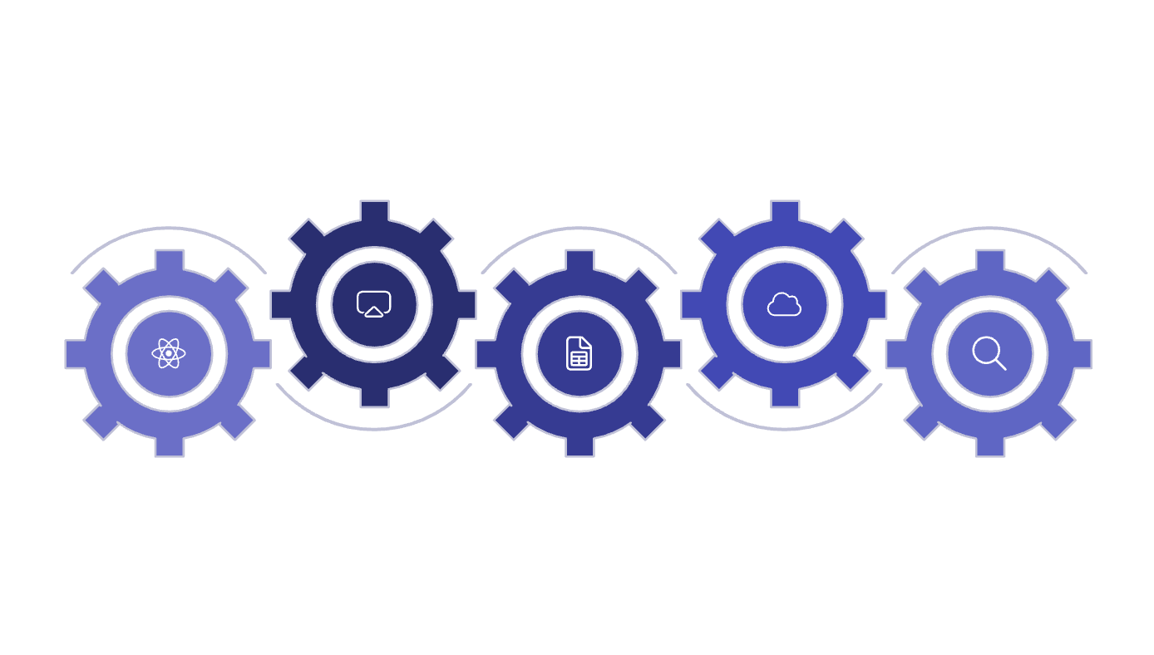





Tech Stack & Architecture
AI Processing
Deployment
Google Gemini AI Studio prompts
Future: Cloud Run services
Frontend
Data Storage
Analytics
Lovable React + Tailwind UI
Google Sheets prototype storage
BigQuery integration planned
Frontend
AI Engine
Lovable Platform: React + Tailwind CSS for responsive, modern user interface design.
Google Cloud Gemini: AI Studio with custom prompt templates for career analysis.
Data & Deployment
Current: Google Sheets prototypeFuture: Cloud Run + BigQuery integration

Slide 6
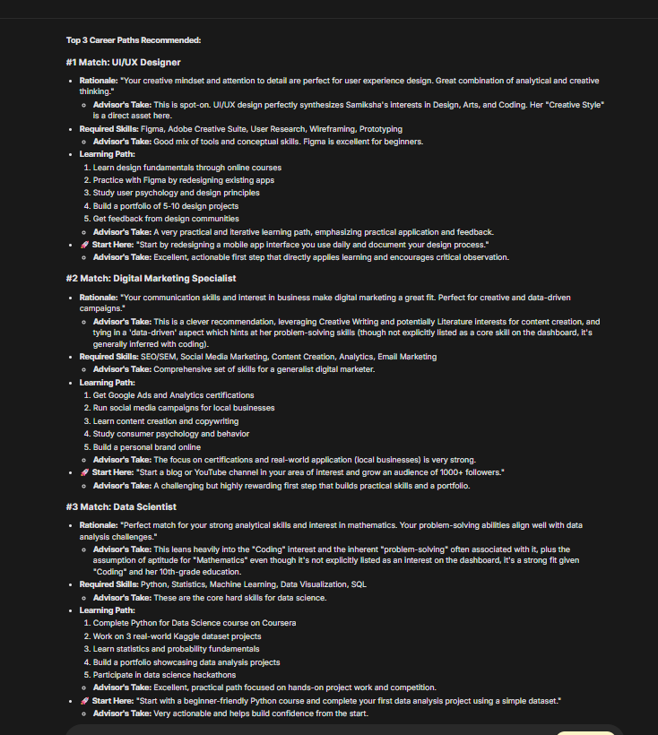
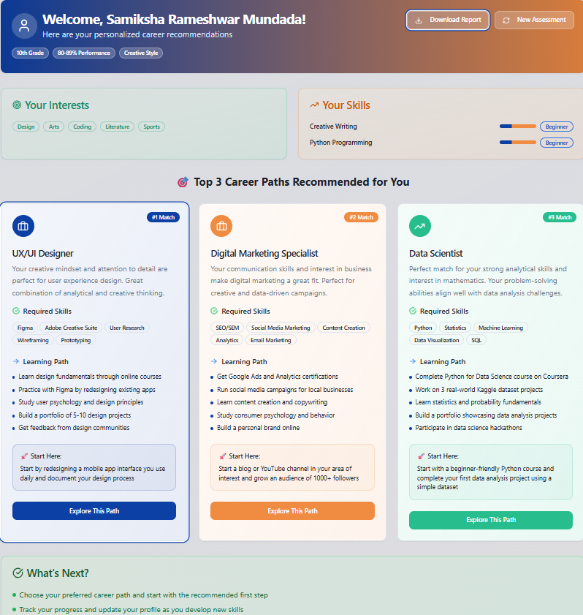
Demo Preview
User Input Form
AI-Generated Results
Personalized career recommendations with detailed skill development paths and learning resources.
Clean, intuitive interface for students to input their skills, interests, and career goals.
01
02
03
Student Input
AI Processing
Career Roadmap
Skills, interests, education goals
Gemini analyzes and matches profiles
Personalized recommendations delivered

Slide 7
System Architecture
Frontend Layer
React-based user interface with responsive design and form validation
AI Processing
Gemini AI Studio with custom prompts for career analysis and recommendations
Data Storage
Google Sheets for prototype, future BigQuery integration for scalability

Slide 8



Technologies Used
Frontend Development
Lovable PlatformReact, Tailwind CSS, TypeScript for modern web development
AI & Machine Learning
Google GeminiAI Studio, prompt engineering, natural language processing
Data & Infrastructure
Google CloudSheets API, Cloud Run, BigQuery for data management

Slide 9
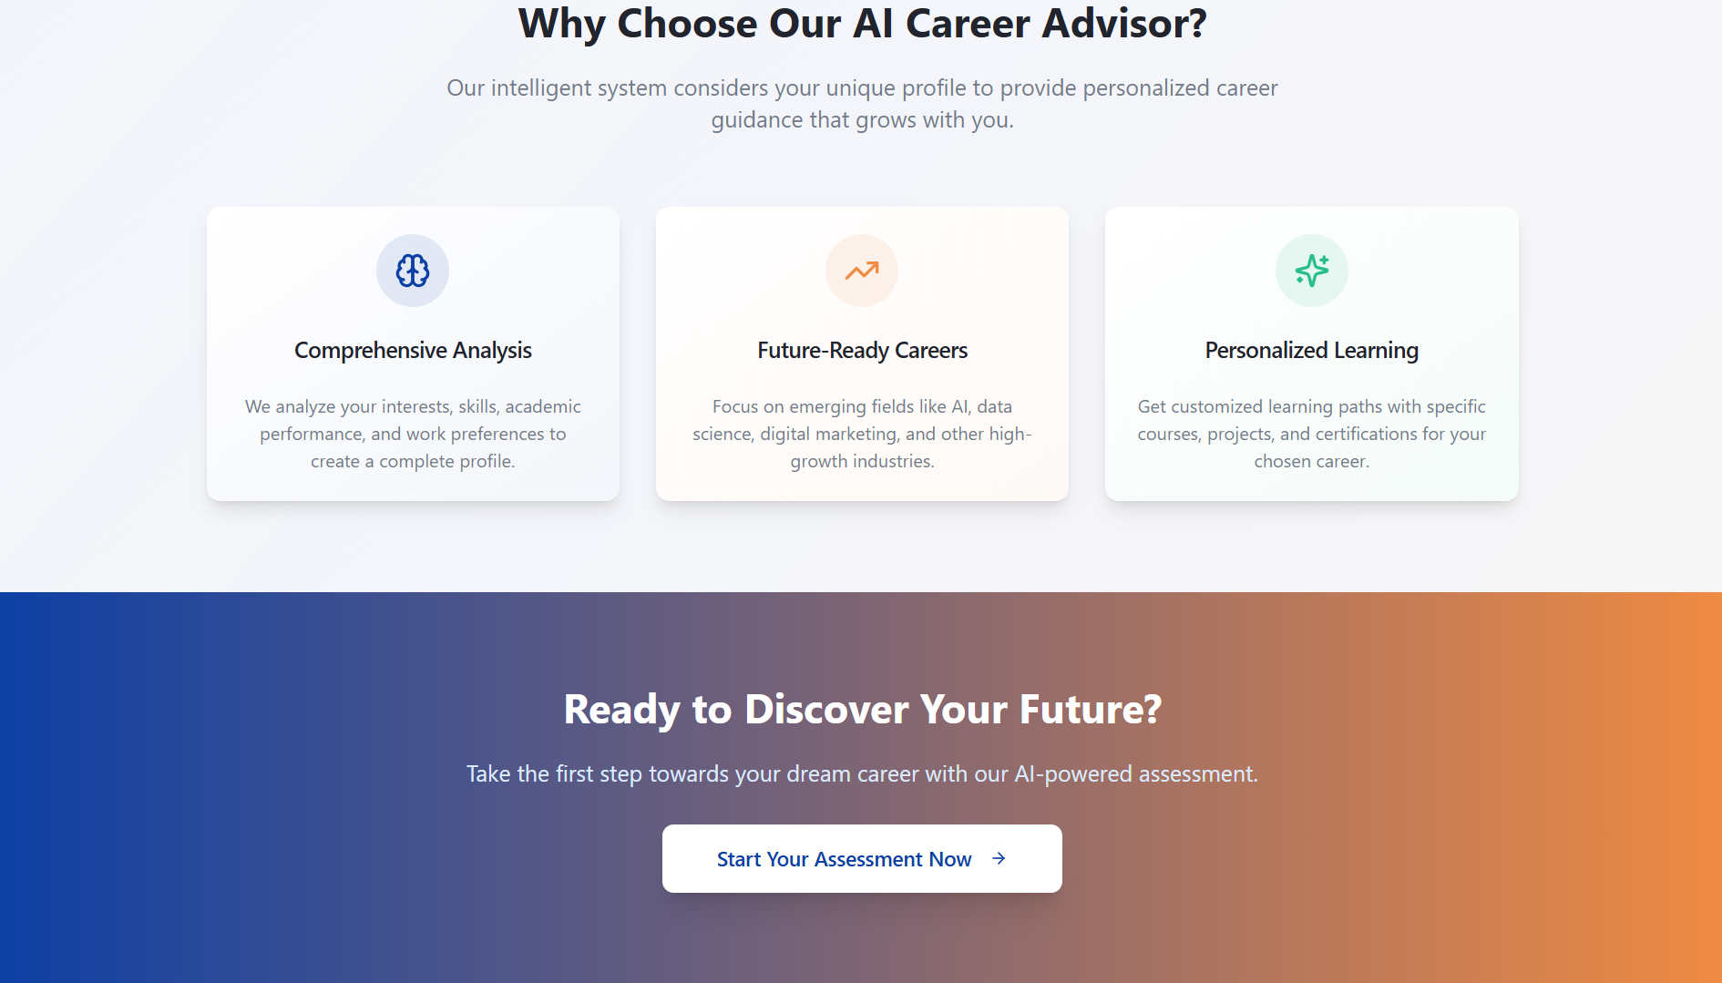
Impact & Benefits
Personalized Guidance
Tailored career advice based on individual strengths, interests, and market demands
Scalable Solution
AI-powered platform can serve thousands of students simultaneously with consistent quality
Accessible & Free
Reduces barriers to quality career guidance, making it available to students across socioeconomic backgrounds

Slide 10
Next Steps
1
Connect UI to Gemini API
Integrate frontend with Google Cloud Gemini for real-time AI processing
2
Deploy Backend Infrastructure
Set up Cloud Run deployment with MCP server for production scalability
3
Expand Database & Features
Migrate to BigQuery, add more career paths, and enhance recommendation algorithms

Slide 11


